Slide 1
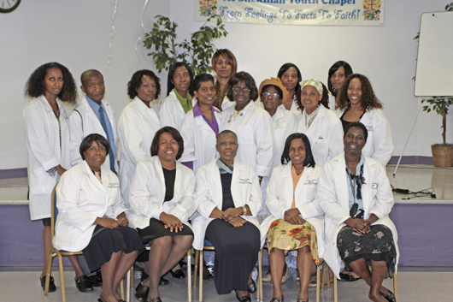
BUILDING BRIDGES TO ABUNDANT LIFE –JESUS
NECHEALTH.ORG
10 DAY MEDICAL MISSIONARY TRAINING LEVEL ONE
Notes:
1

Slide 2
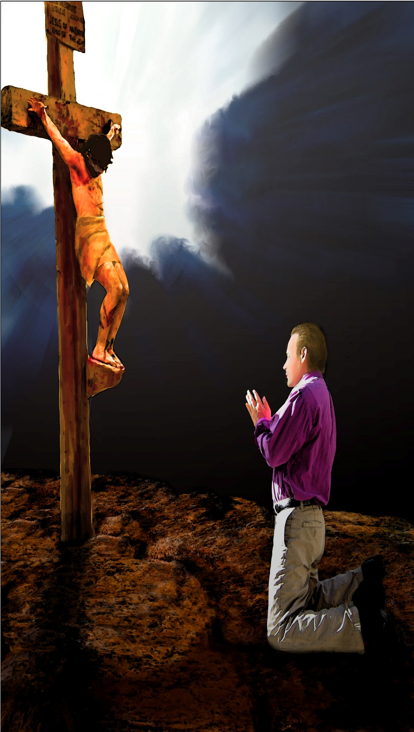
We should ever remember that the object of the medical missionary work is to point sin-sick men and women to the Man of Calvary, who taketh away the sin of the world. By beholding Him, they will be changed into His likeness. We are to encourage the sick and suffering to look to Jesus and live. {MH 144.}

Slide 3
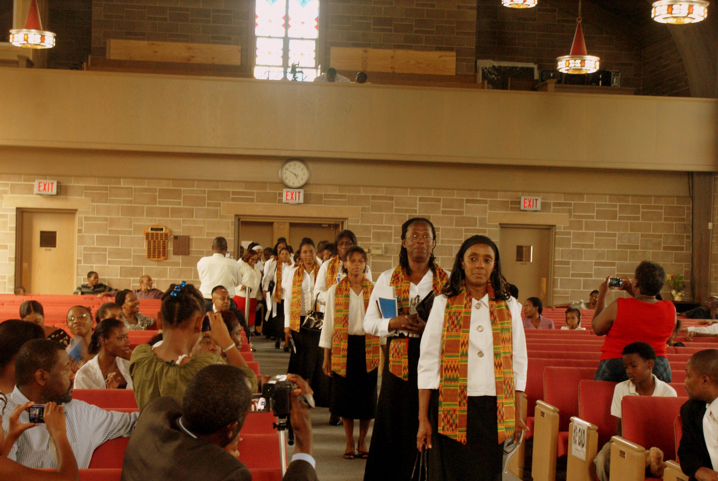
Wilderness Graduation

Slide 4
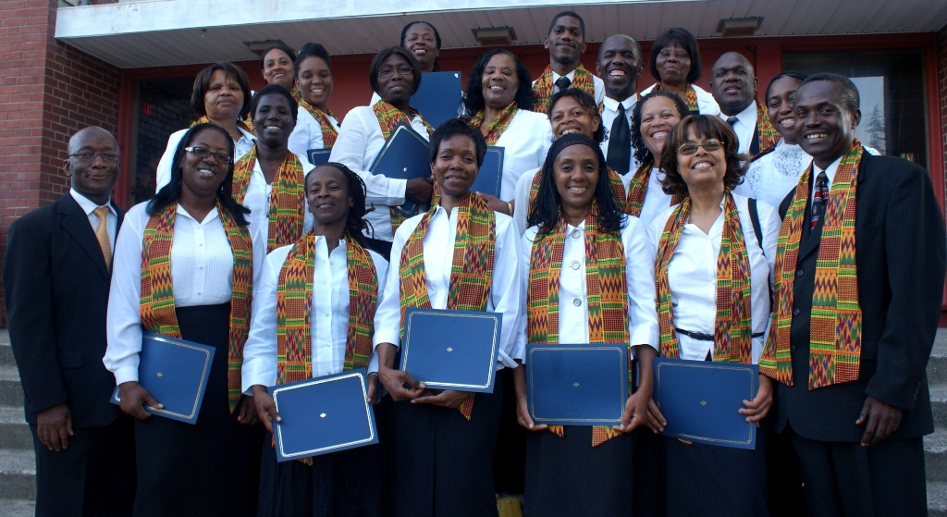

Slide 5
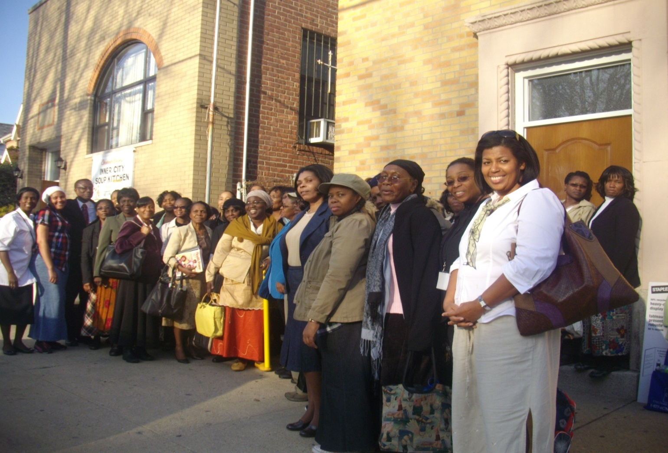
MEDICAL MISSIONARY TRAINING
Brooklyn, New York
nechealth.org

Slide 6
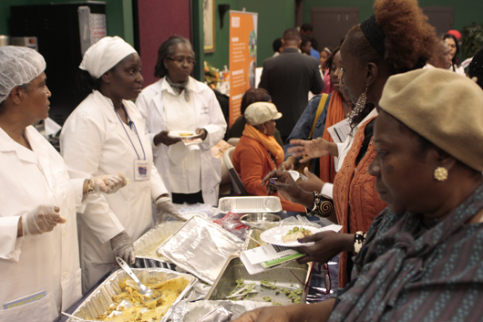
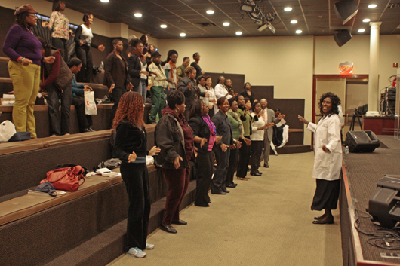
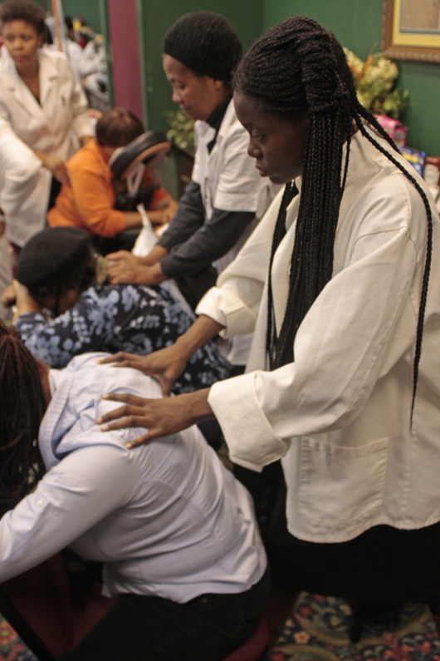
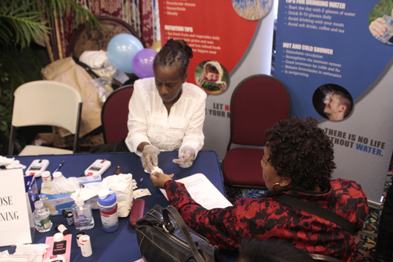
EXPO AT CHRISTIAN CULTURAL CENTER, BROOKLYN,NY

Slide 7
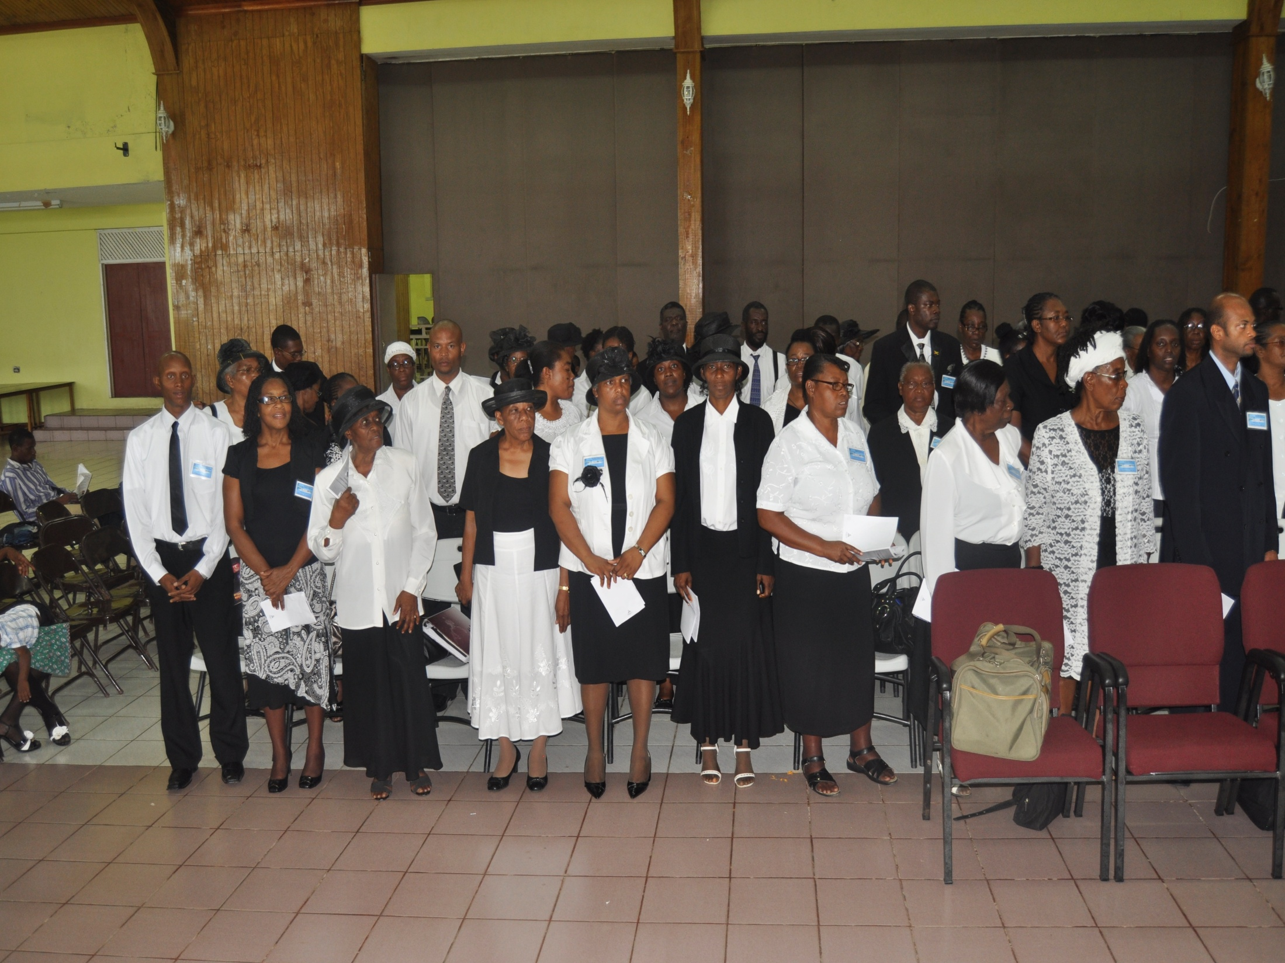
JAMAICA MEDICAL MISSIONARY GRADUATES

Slide 8
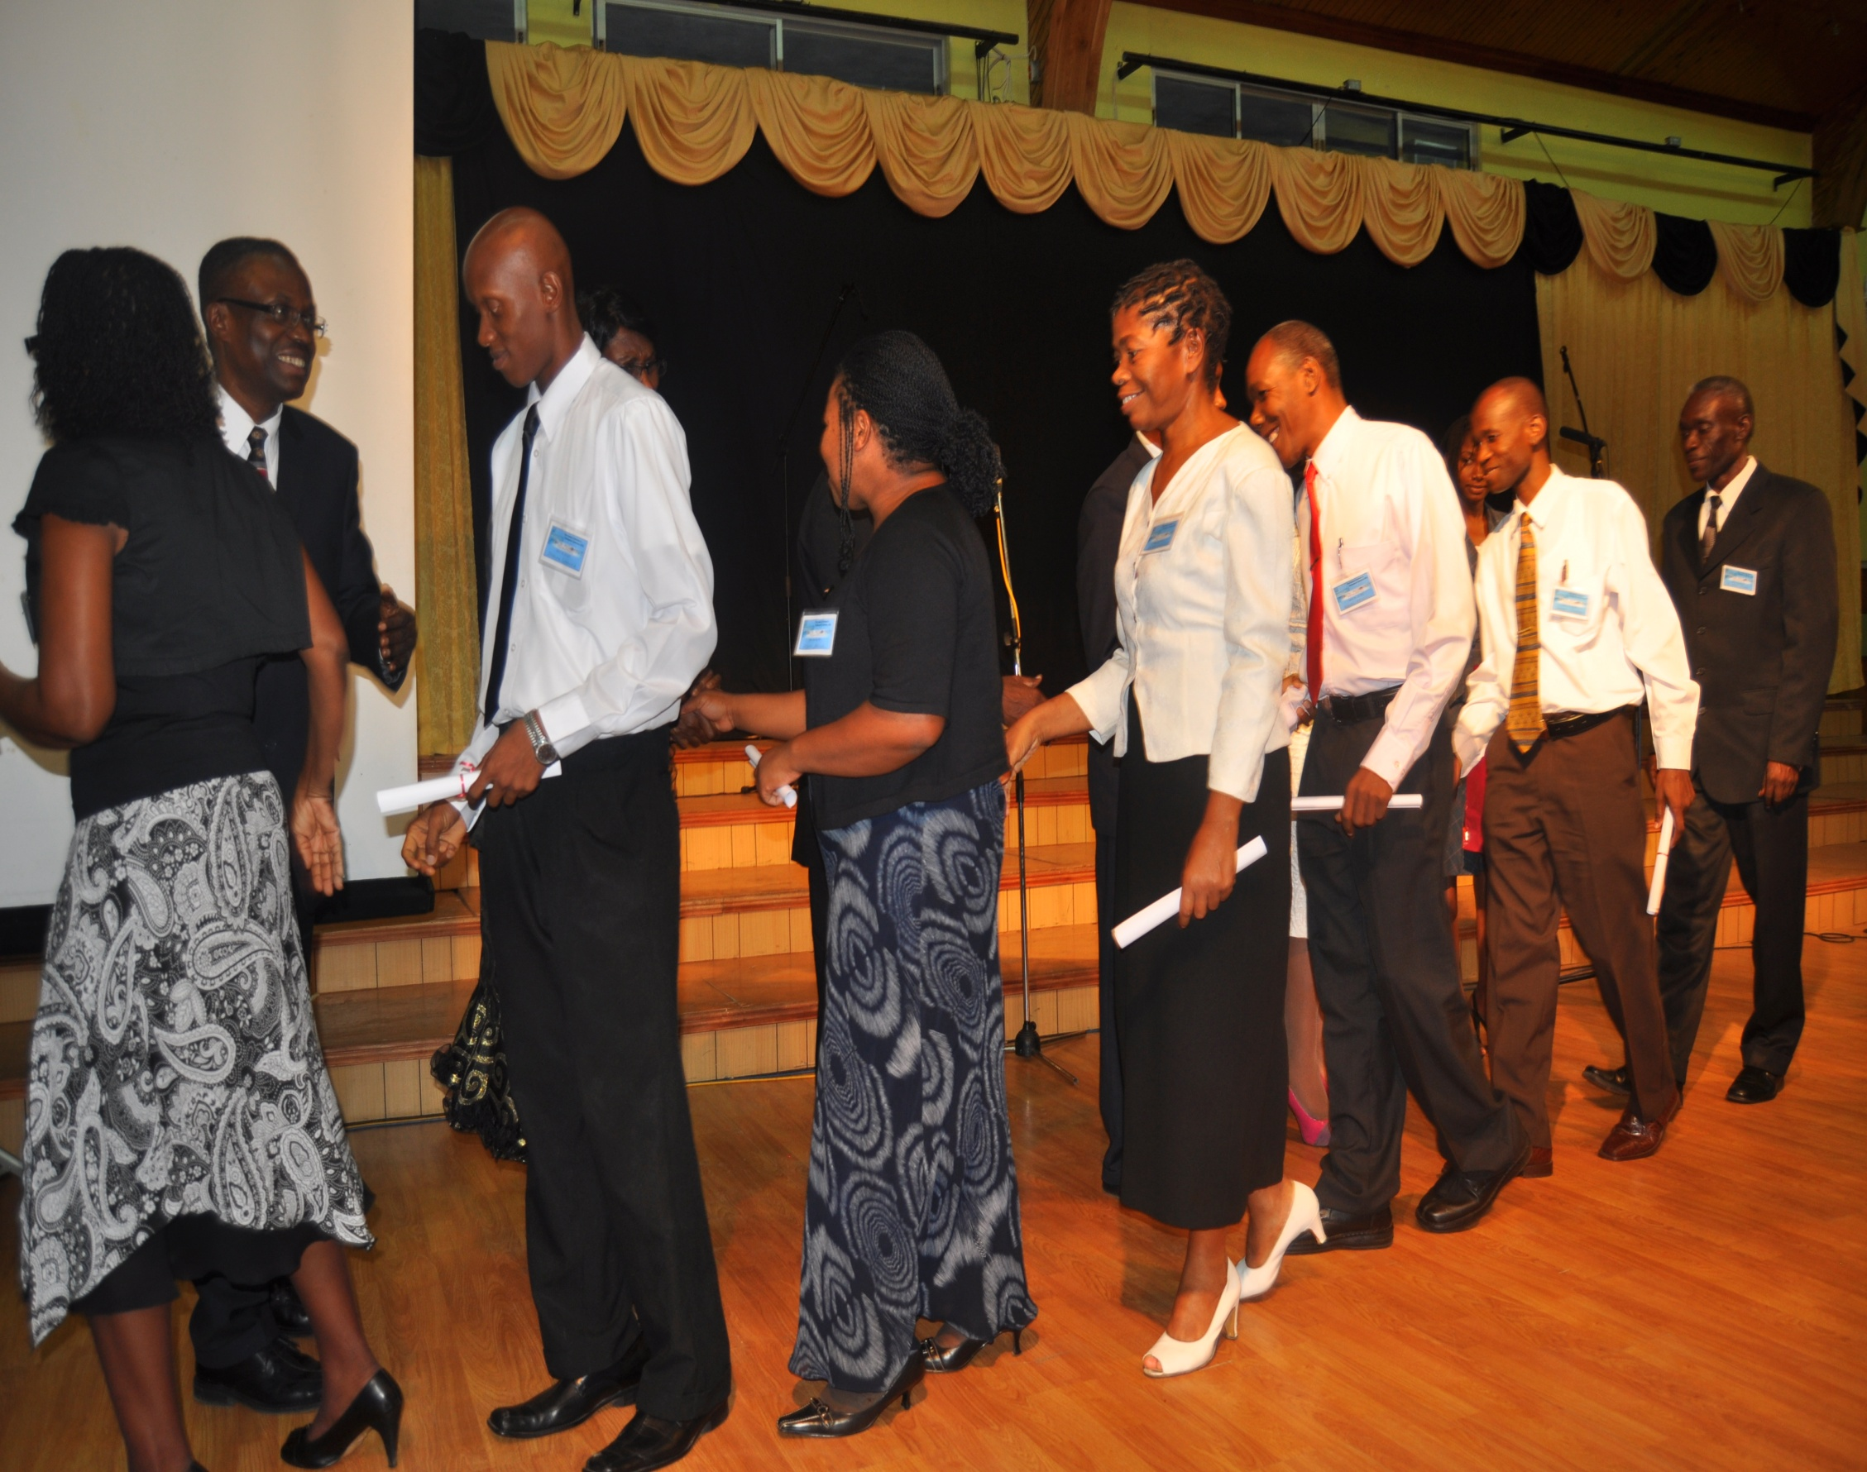
MM GRADUATION JAMAICA WEST INDIES MAY 2011

Slide 9

MEDICAL MISSIONARY WORK IS SWEET

Slide 10
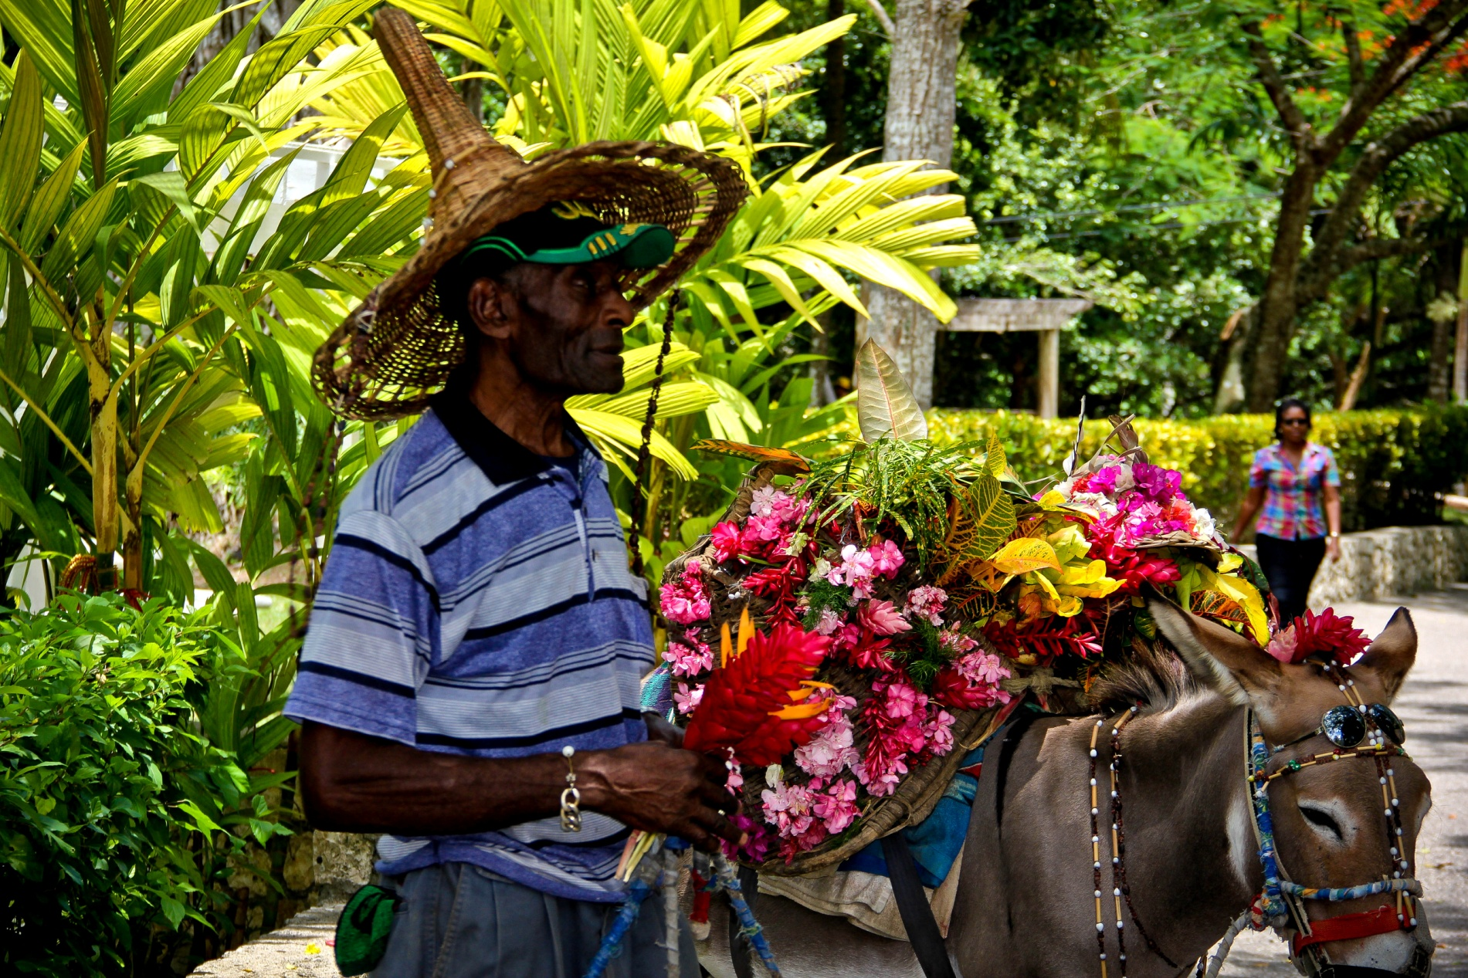
93 Graduated in Jamaica,

Slide 11
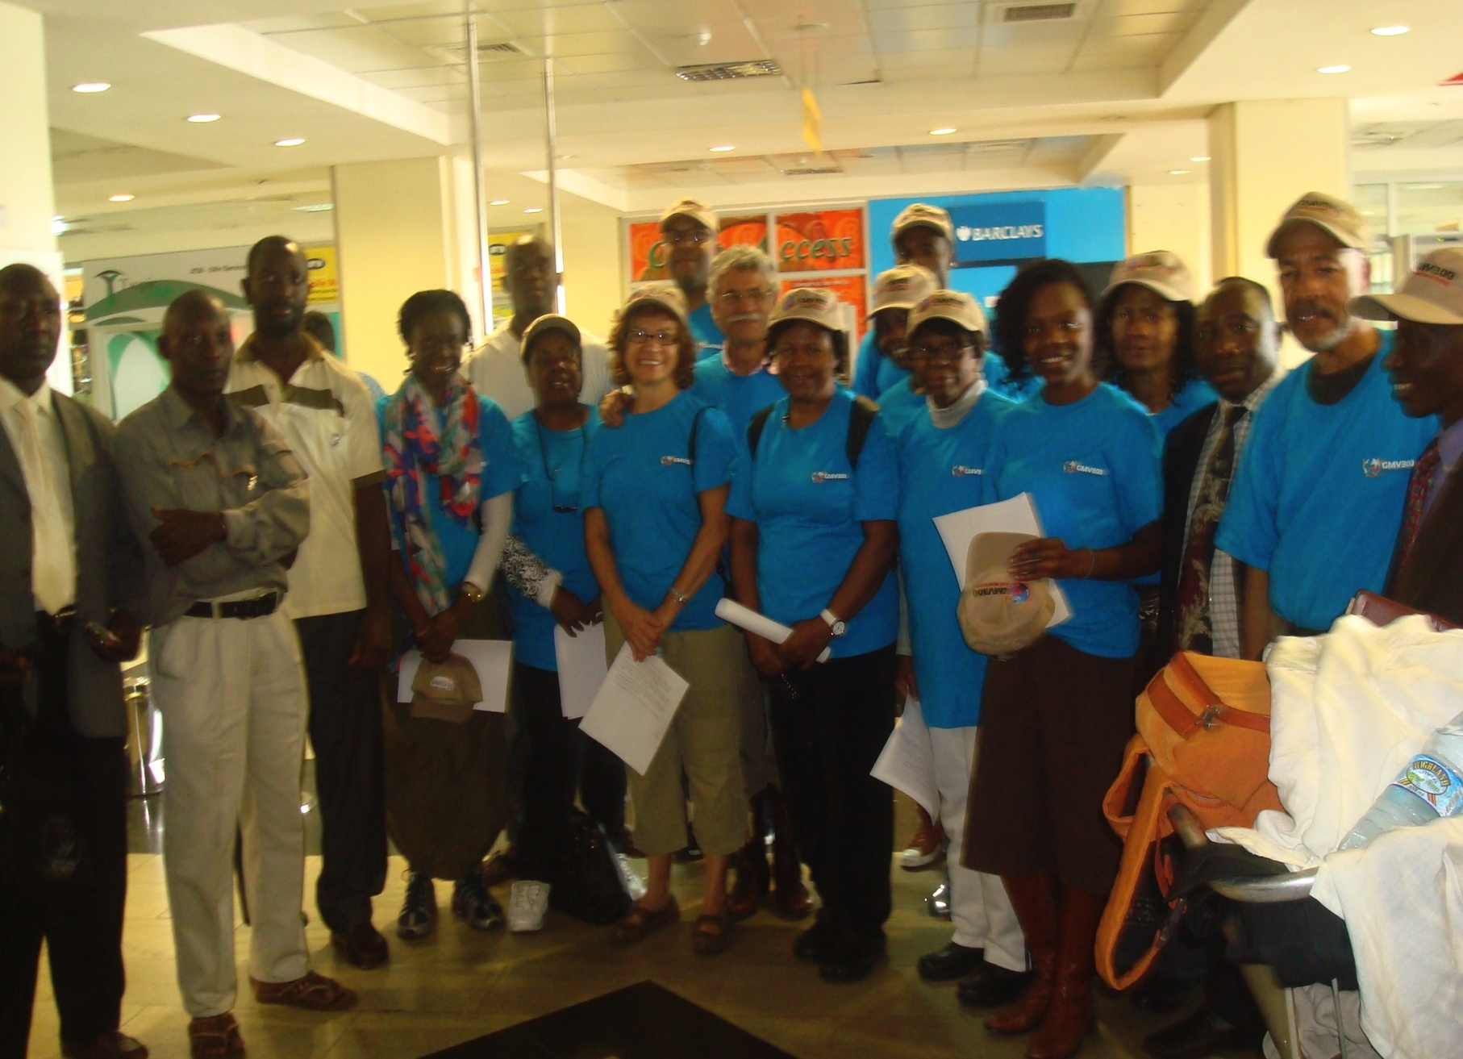
UGANDA

Slide 12
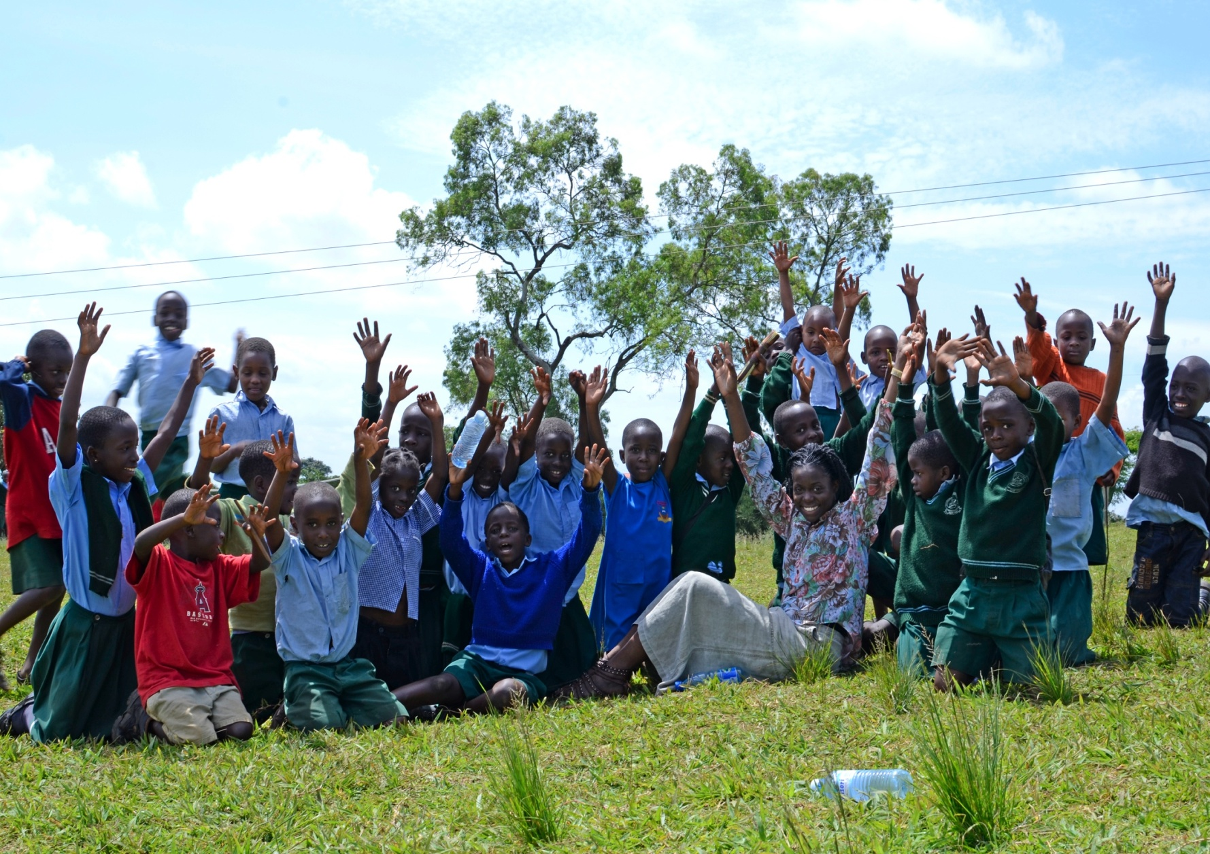
UGANDA TRAINING

Slide 13
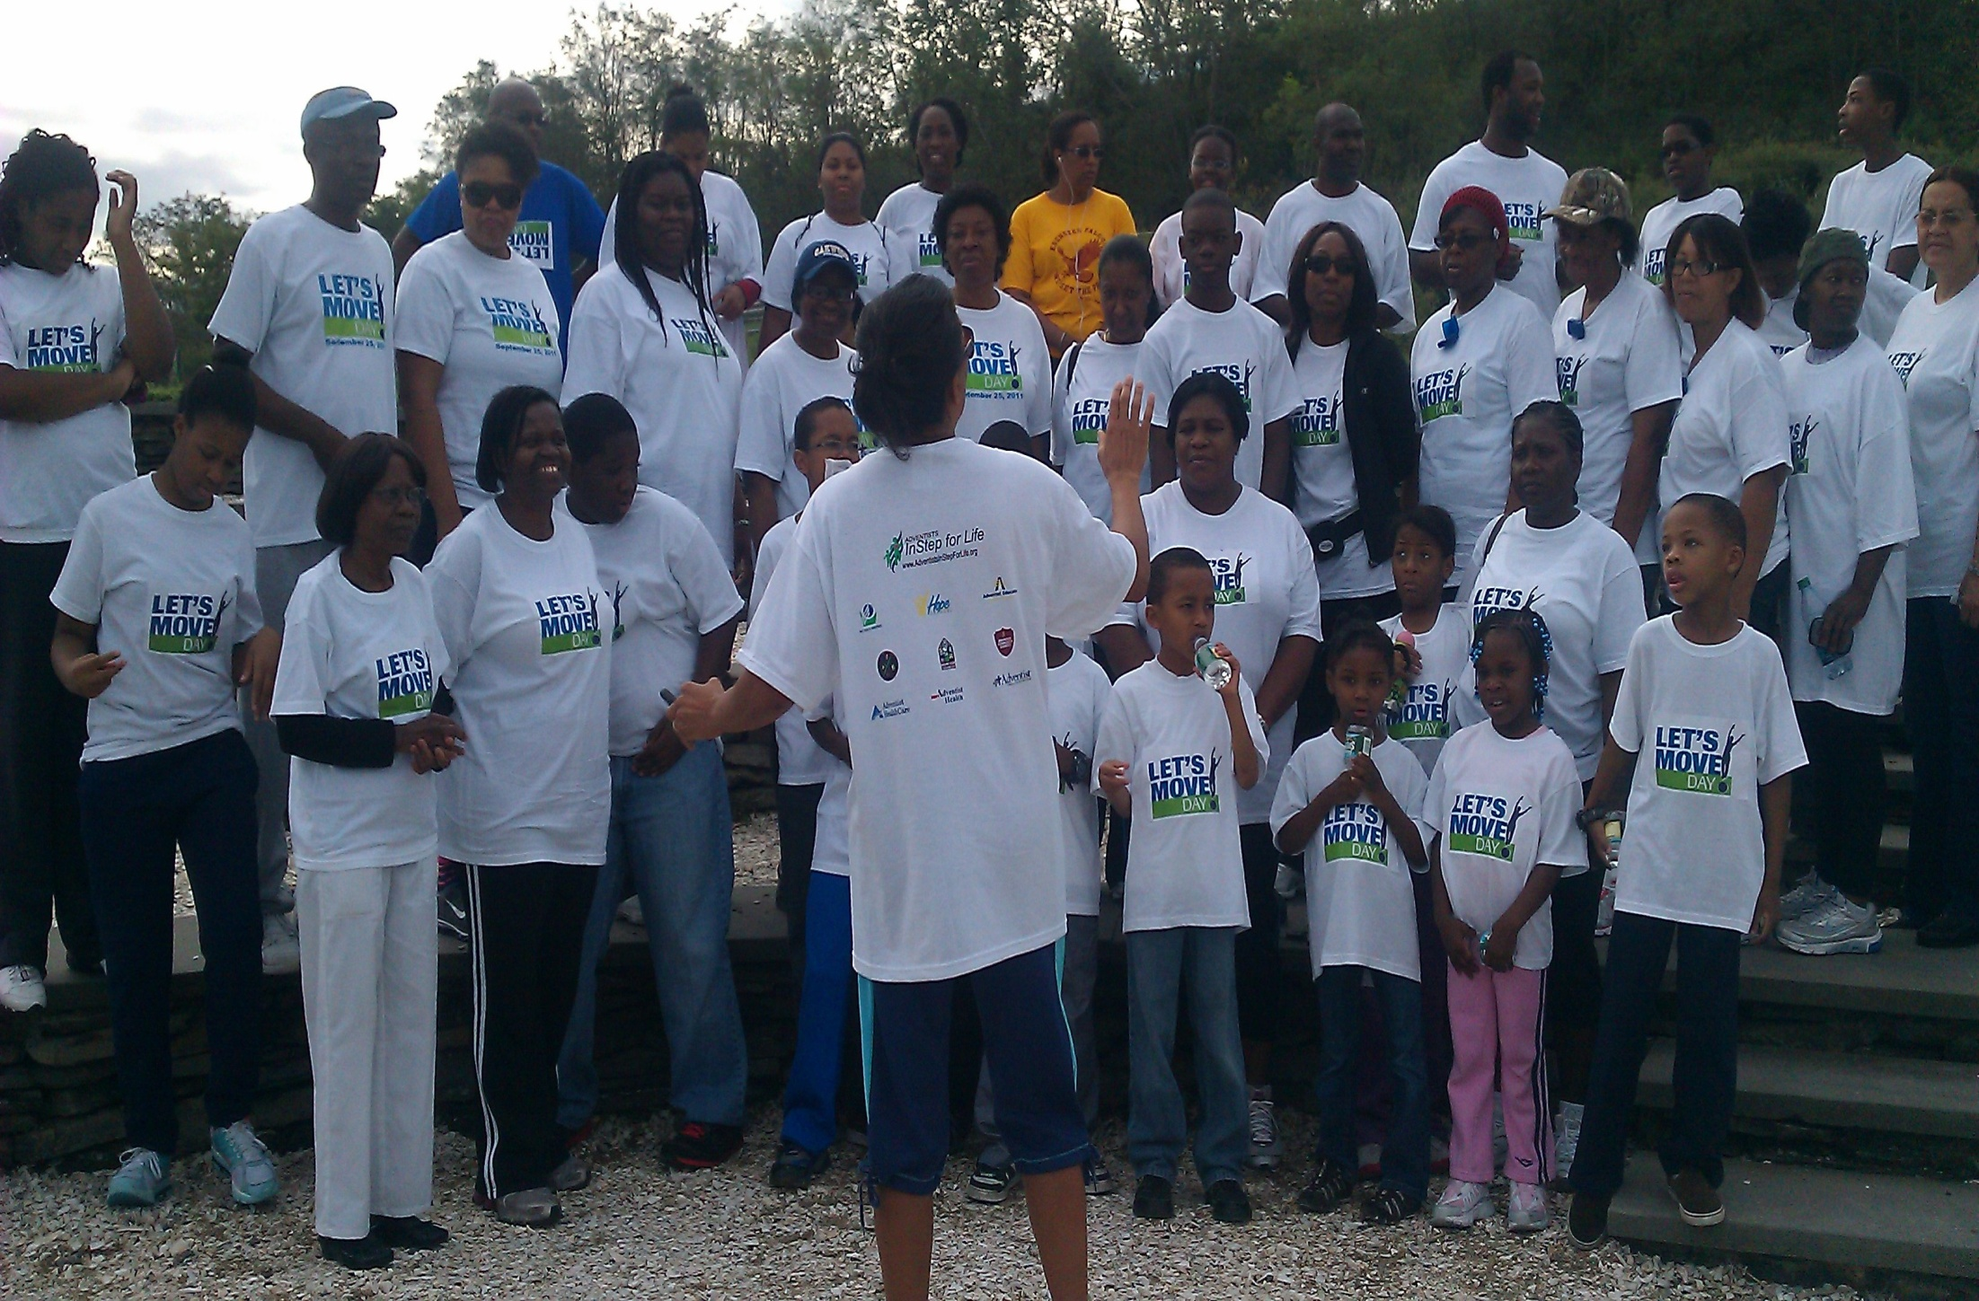
LET’S MOVE! LET’S MOVE

Slide 14
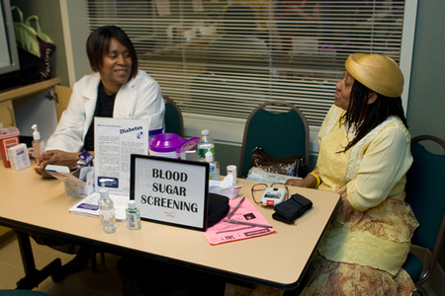
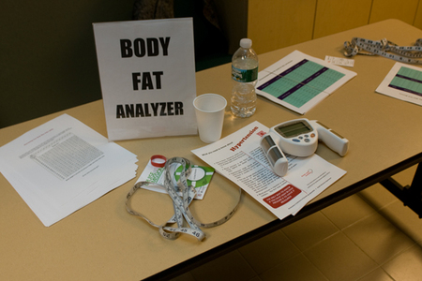
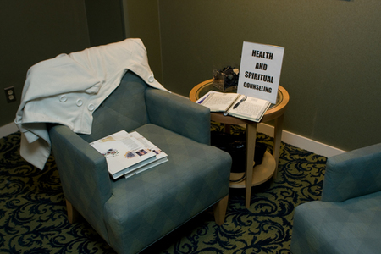
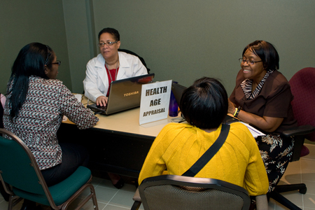
KNOW YOUR NUMBERS SCREENING

Slide 15
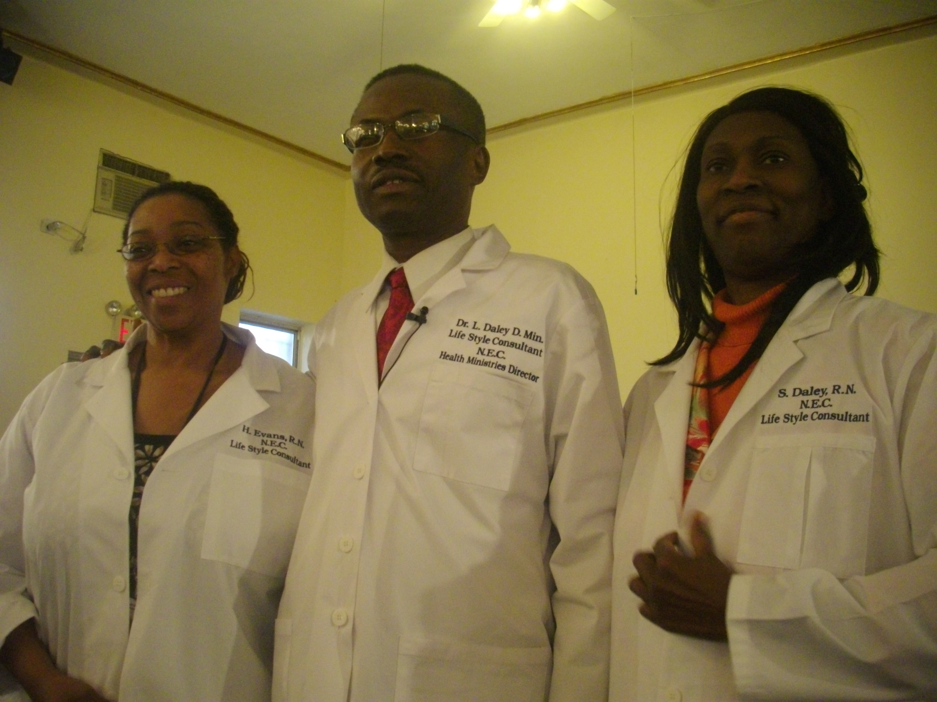
nechealth.org

Slide 16
We should ever remember that the object of the medical missionary work is to point sin-sick men and women to the Man of Calvary, who taketh away the sin of the world.
THE MAN OF CALVARY
{MH 144.}

